Slide 1
Transmission Media - Guided
TWISTED PAIR:
Simply two wires twisted together - the twisting cuts down on electrical interference.
Heavily used in the phone system.
Category 3 and 5 - with 5 having more twists and better insulation.

Slide 2
BASEBAND COAXIAL CABLE
Used for digital transmissions (called baseband.)
Good noise immunity.
Data rates as high as 1 Gbps for short distances.
Now being replaced by fiber.

Slide 3
BROADBAND COAXIAL CABLE:
Used for analog transmissions (called broadband.)
Can run 300 MHz for long distances.
Analog signaling has better S/N than digital signaling.
Interfaces must convert digital signals to analog and vice versa.
Designed for long distances - can use amplifiers.

Slide 4
FIBER OPTICS:
Transmission of light through fiber - properties include total internal reflection and attenuation of particular frequencies.
Fiber Optic Networks - can be used for LANs.

Slide 5
UnGuided Media
Unguided media is a type of Transmission Media. Unguided media transport electromagnetic waves without using a physical conductor. It is also known as unbounded or wireless media, and does not rely on physical pathways to transmit signals.

Slide 6
Different Networks devices
HUB
Bridge
Switch
Router
Gateways

Slide 7
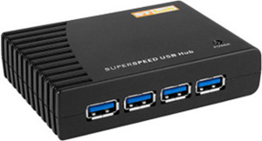
HUB
Hubs work in the physical layer of the OSI model. A hub is a device for connecting multiple Ethernet devices and making them act as a single network segment. It has multiple inputs and output ports in which a signal introduced at the input of any port appears at the output of every port except the original incoming port.
A hub can be used with both digital and analog data. Hubs do not perform packet filtering or addressing function, they send the data packets to all the connected devices.

Slide 8
Bridge
A bridge is a type of computer networking component that builds the connection between two local-area networks.
A bridge operates at the data link layer of the OSI model. It can read only the outmost hardware address of the packet but cannot read the IP address. It reads the outmost section of the data packet to tell where the message is going. It reduces the traffic on other network segments. It does not send all the packets. So, a bridge can be programmed to reject packets from a particular network.

Slide 9
Switch
Switches work as the connection points for an Ethernet network. Just like in the hub, devices in switches are linked to them through twisted-pair cabling.
Switches may operate at one or more layers of the OSI model. They may operate in the data link layer and network layer; a device that operates simultaneously at more than one of these layers is known as a multilayer switch.
A Switch can check the errors before forwarding the data, which makes it more efficient and improves its performance. A switch is the better version of a hub. It is a multi-port bridge device.

Slide 10
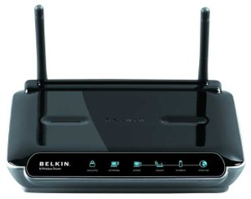
Router
Routers are network layer components and are particularly categorized as Layer- 3 components of the OSI Model. They work on logical addressing information in the Network header of a packet like IP Addresses.

Slide 11
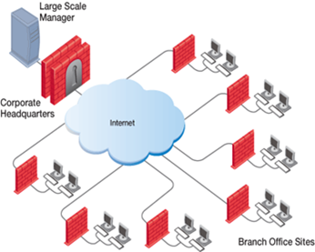
Gateways
Gateway is a device that is implemented to combine multiple networks and transmits packets from one network to the other network.

